Slide 1
Math 769: Statistical Learning

Slide 2
Formal Description of the Statistical Learning Problem
Shahrzad Jamshidi, PhD

Slide 3
Last Time
In the last few lectures, we’ve discussed
what a statistical learning problem is,
what kinds of data might influence how we go about the problem, and
what other considerations exist when analyzing potential models.
In this lesson, we provide a formal description for the statistical learning problem from a statistical perspective.
Note: it’s ok if this lecture feels confusing
Notes:
Depending on your prerequisite classes, the content of this lecture may be beyond your mathematical training. By the end of this course, however, you will see that the descriptions we provide here will appear again and again for all the models we cover. Over time, the formalism will feel more and more familiar to you. My advice: be patient and don’t stress too much about the details right now.

Slide 4
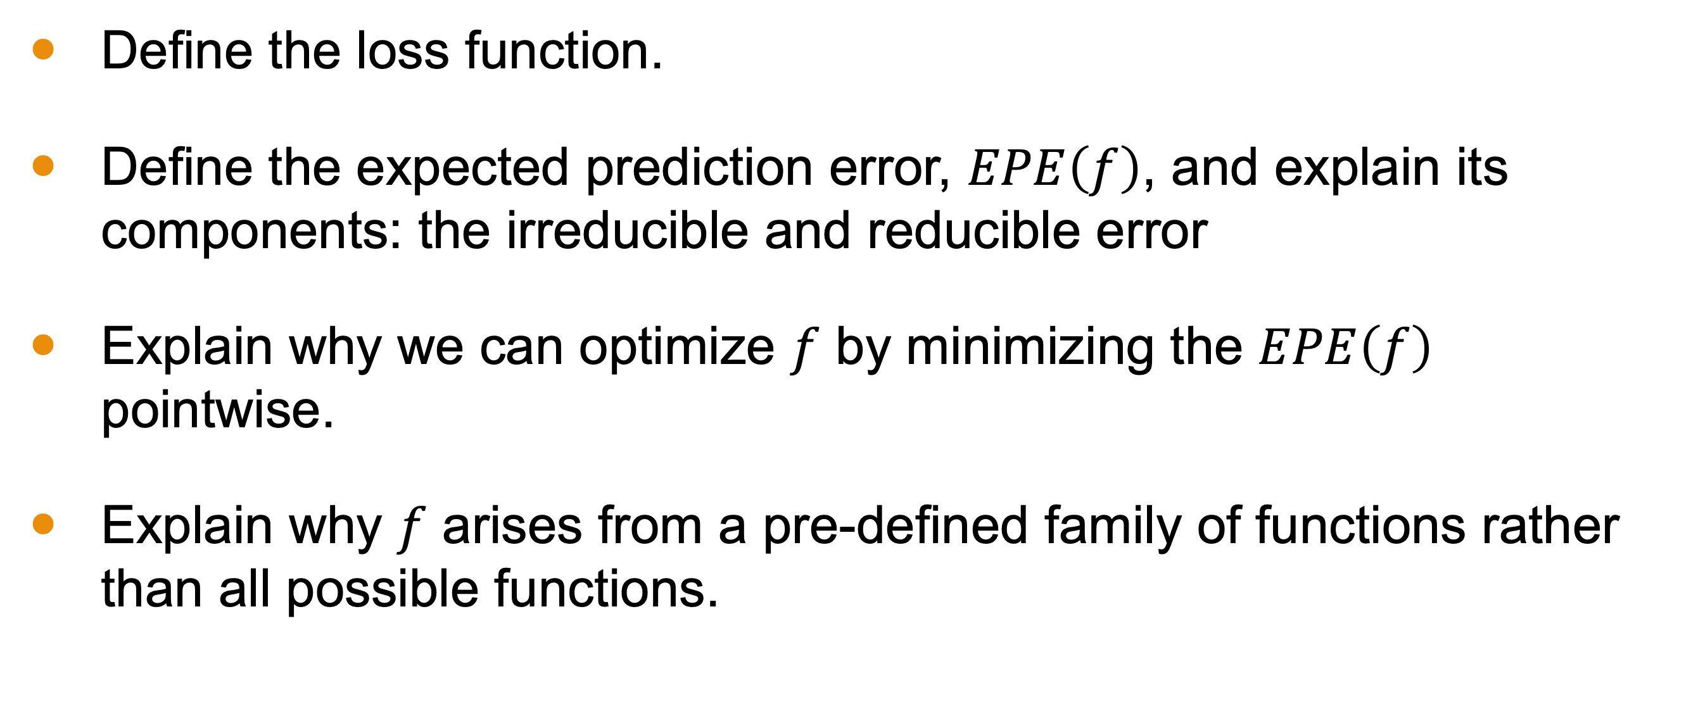
Objectives
Define the loss function.
Define the expected prediction error, $EPE\left(f\right)$, and explain its components: the irreducible and reducible error
Explain why we can optimize $f$ by minimizing the $EPE\left(f\right)$ pointwise.
Explain why $f$ arises from a pre-defined family of functions rather than all possible functions.
Notes:
Depending on your prerequisite classes, the content of this lecture may be beyond your mathematical training. By the end of this course, however, you will see that the descriptions we provide here will appear again and again for all the models we cover. Over time, the formalism will feel more and more familiar to you. My advice: be patient and don’t stress too much about the details right now.

Slide 5
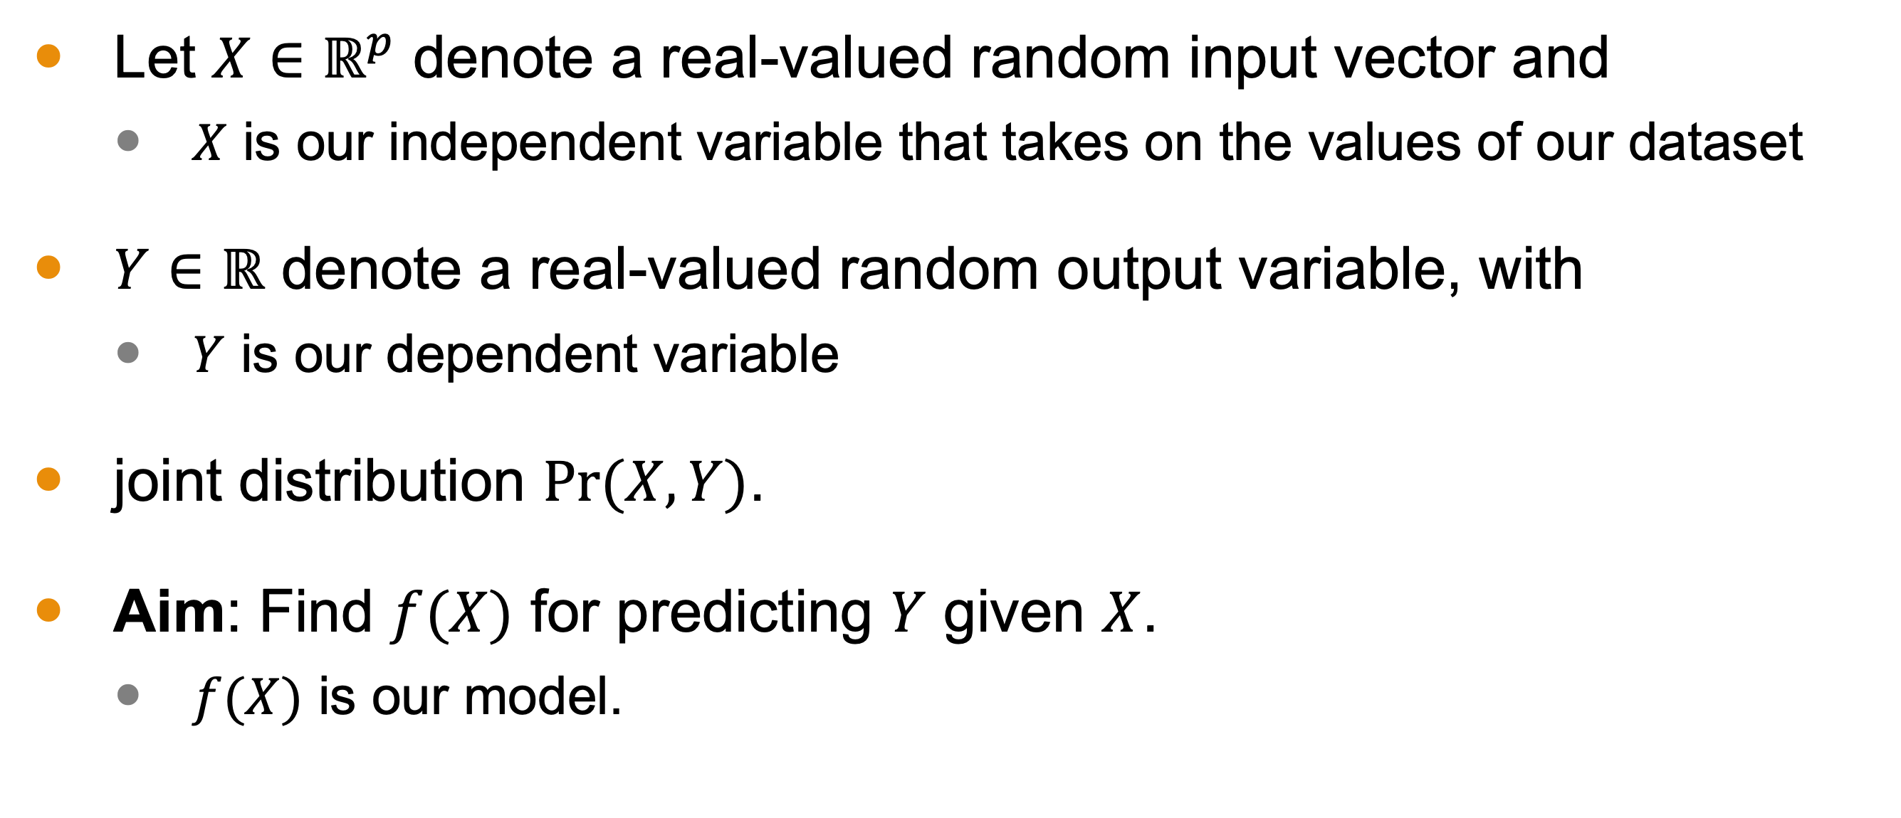
Formal Setup
Let $X∈ℝ^{p}$ denote a real-valued random input vector and
$X$ is our independent variable that takes on the values of our dataset
$Y∈ℝ$ denote a real-valued random output variable, with
$Y$ is our dependent variable
joint distribution $Pr⁡(X,Y)$.
Aim: Find $f(X)$ for predicting $Y$ given $X$.
$f(X)$ is our model.

Slide 6
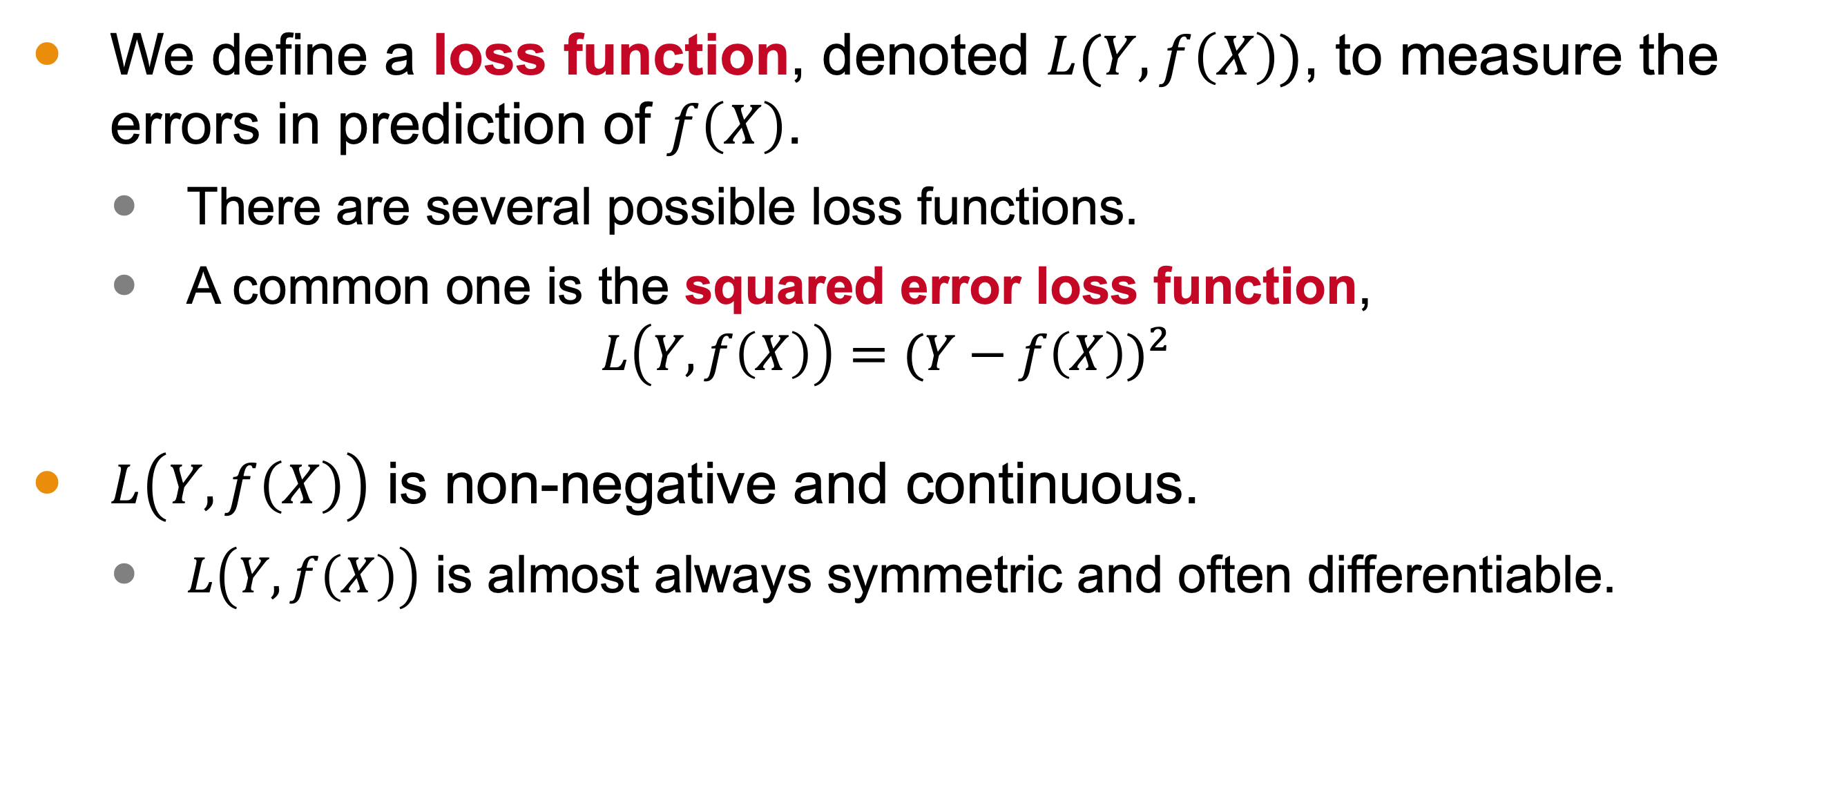
The Loss Function
We define a loss function, denoted $L(Y, f\left(X\right))$, to measure the errors in prediction of $f\left(X\right)$.
There are several possible loss functions.
A common one is the squared error loss function,
$$L\left(Y, f\left(X\right)\right)={(Y−f\left(X\right))}^{2}$$
$L\left(Y, f\left(X\right)\right)$ is non-negative and continuous.
$L\left(Y, f\left(X\right)\right)$ is almost always symmetric and often differentiable.

Slide 7
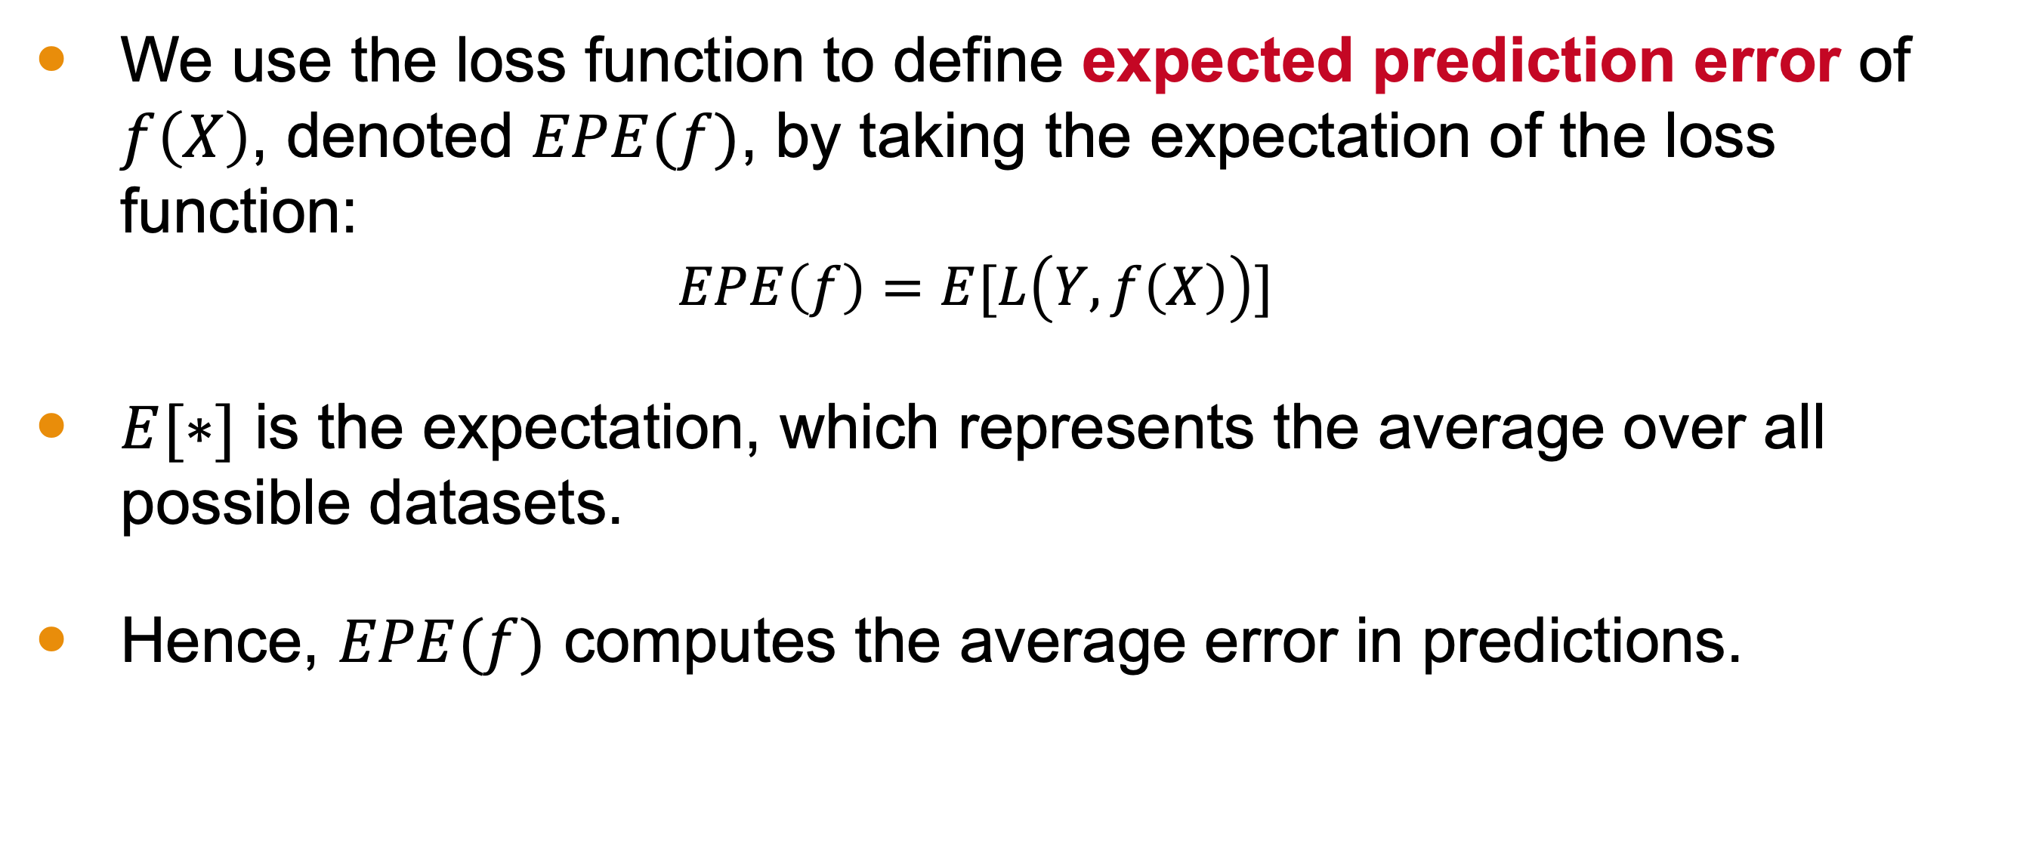
The Expected Prediction Error
We use the loss function to define expected prediction error of $f\left(X\right)$, denoted $EPE(f)$, by taking the expectation of the loss function:
$$EPE\left(f\right)=E[L\left(Y, f\left(X\right)\right)]$$
$E[∗]$ is the expectation, which represents the average over all possible datasets.
Hence, $EPE(f)$ computes the average error in predictions.

Slide 8
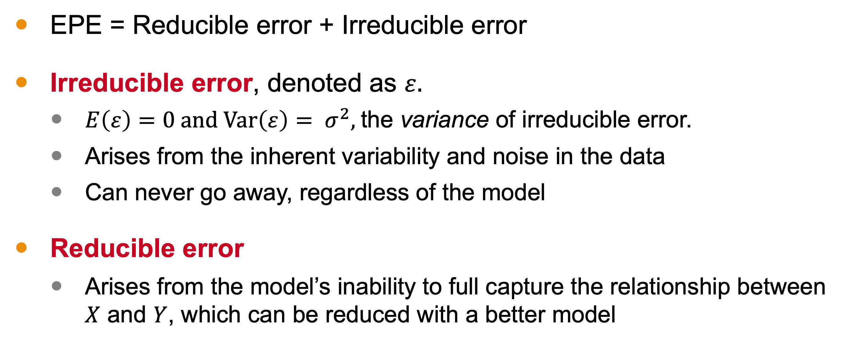
Components of EPE
EPE = Reducible error + Irreducible error
Irreducible error, denoted as $ε.$
$E\left(ε\right)=0$ and $\text{Var}\left(ε\right)= σ^{2},$ the variance of irreducible error.
Arises from the inherent variability and noise in the data
Can never go away, regardless of the model
Reducible error
Arises from the model’s inability to full capture the relationship between $X$ and $Y$, which can be reduced with a better model

Slide 9
Our aim is to minimize EPE. So, what are we minimizing?

Slide 10
The reducible error!

Slide 11
That means we are changing $f\left(X\right)$!

Slide 12
But how???

Slide 13

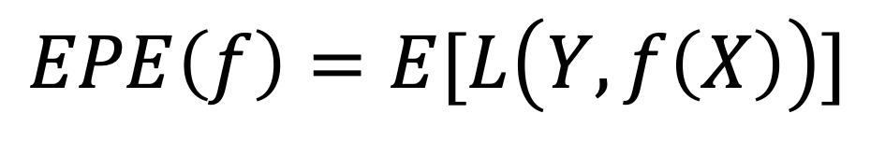
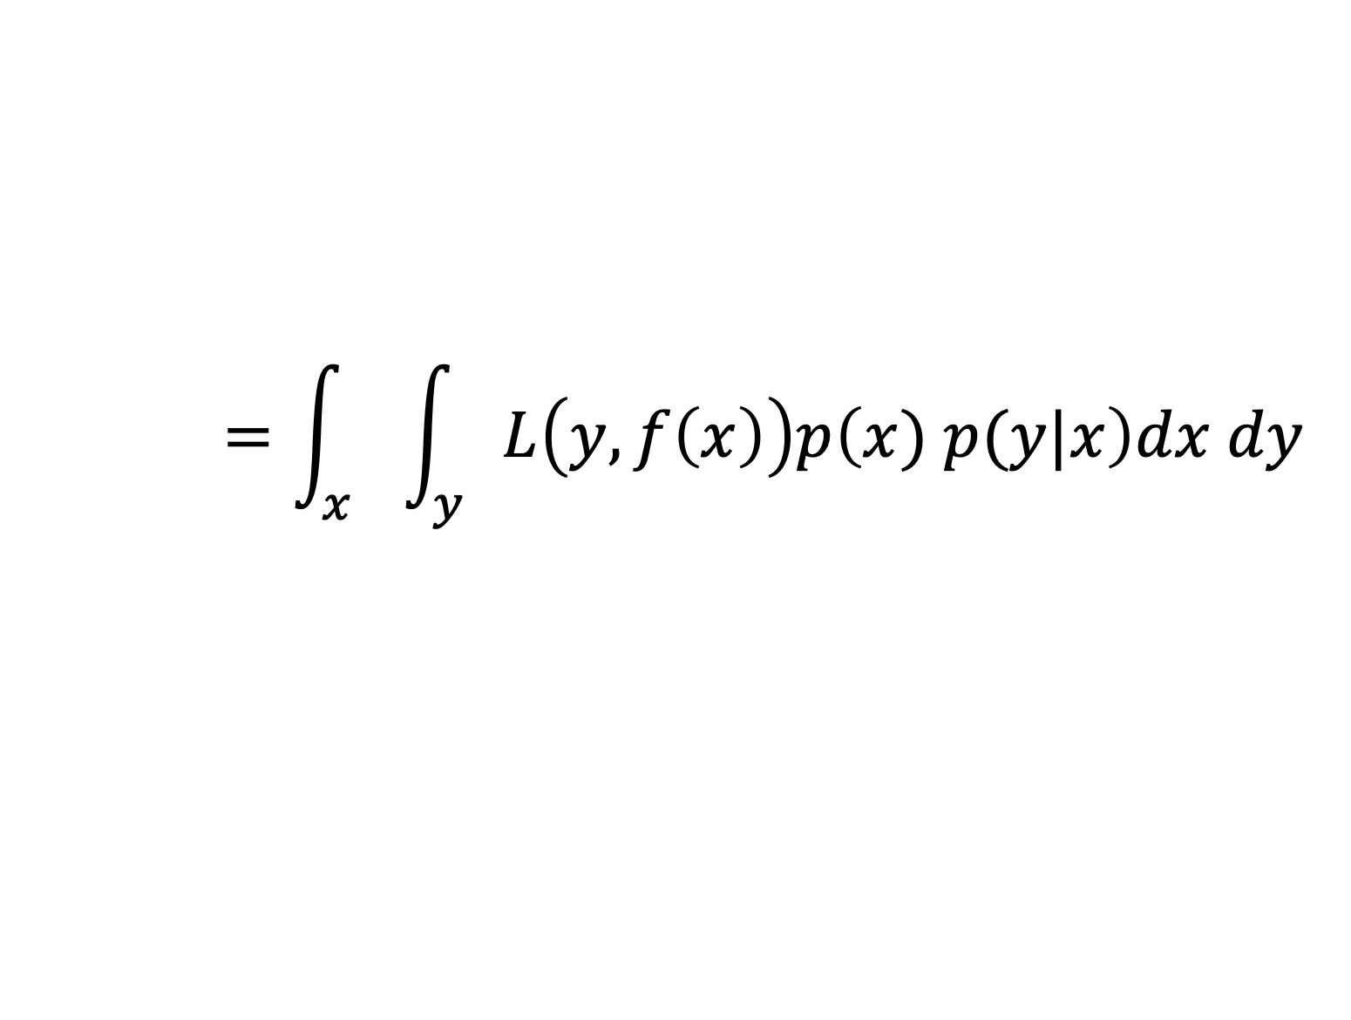
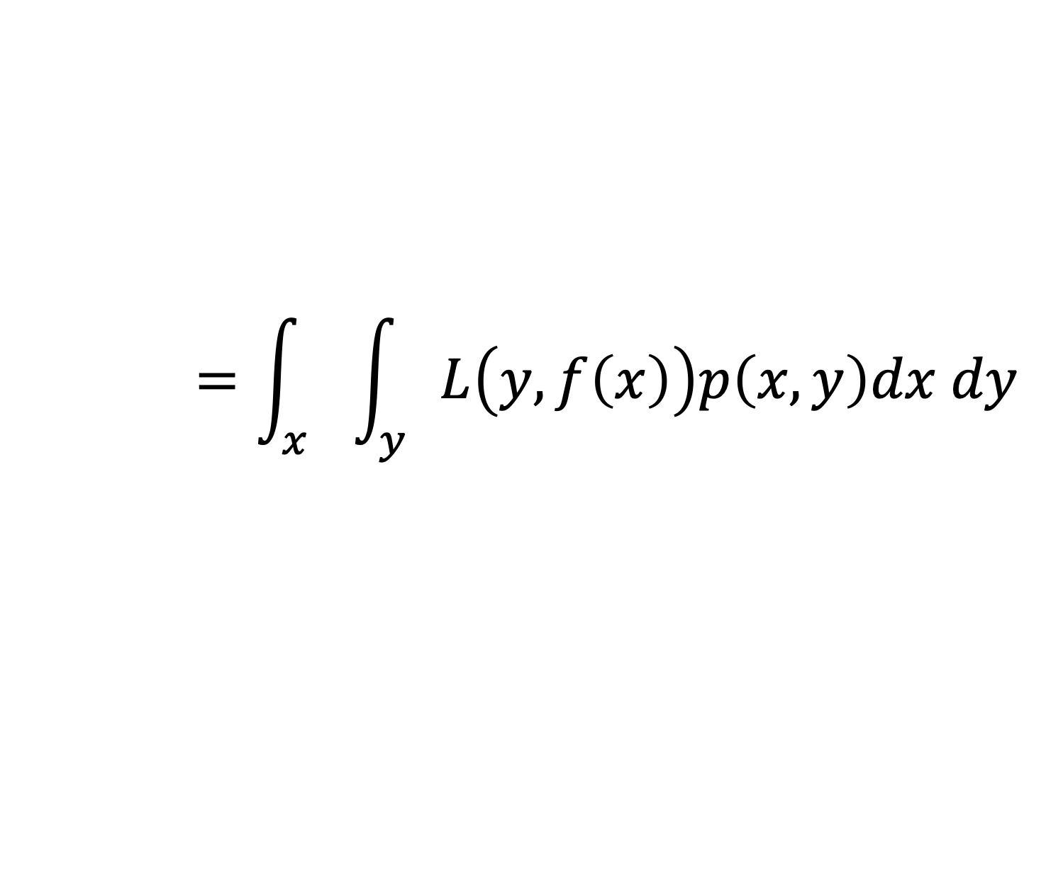
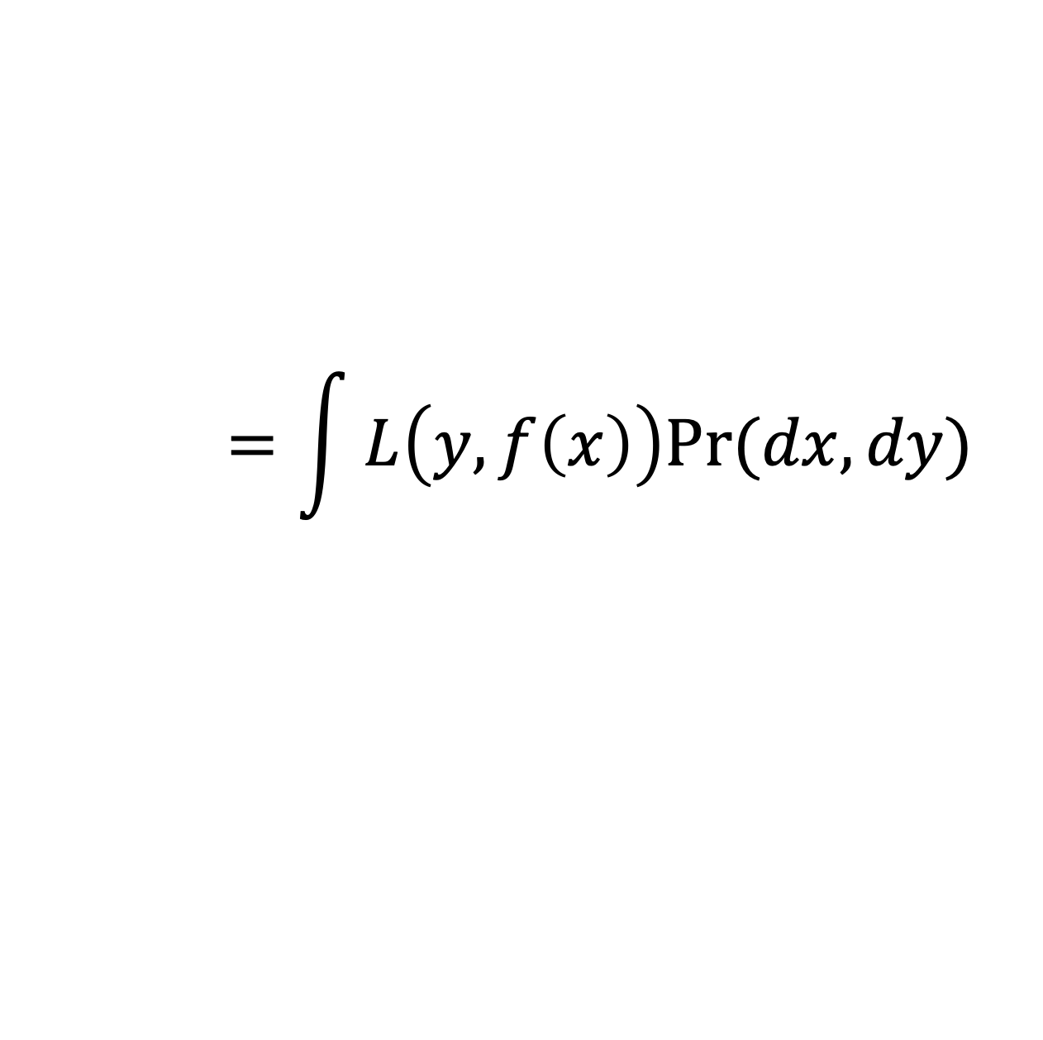
Derivation of $EPE(f)$
$$EPE\left(f\right)=E[L\left(Y, f\left(X\right)\right)]$$
Definition of EPE.
$$=\int{L\left(y, f\left(x\right)\right)Pr⁡(dx, dy)}$$
Definition of expectation.
$$=\int_{x}{\int_{y}{L\left(y, f\left(x\right)\right)p\left(x, y\right)dx dy}}$$
Definition of the probability density function
$$=\int_{x}{\int_{y}{L\left(y, f\left(x\right)\right)p\left(x) p(y|x\right)dx dy}}$$
The chain rule for conditional probabilities

Slide 14

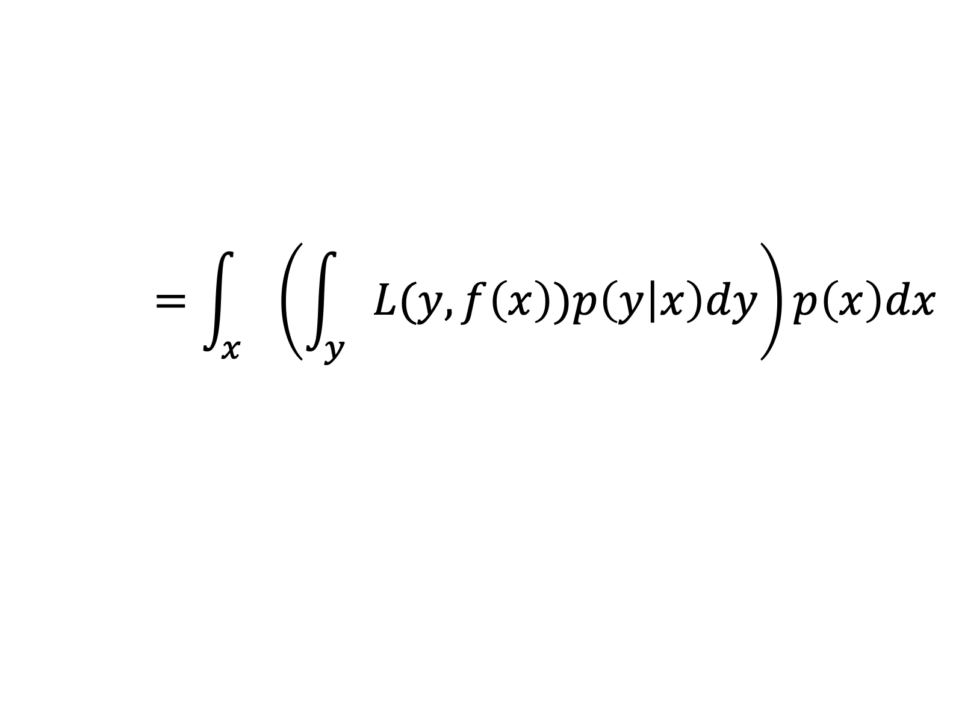

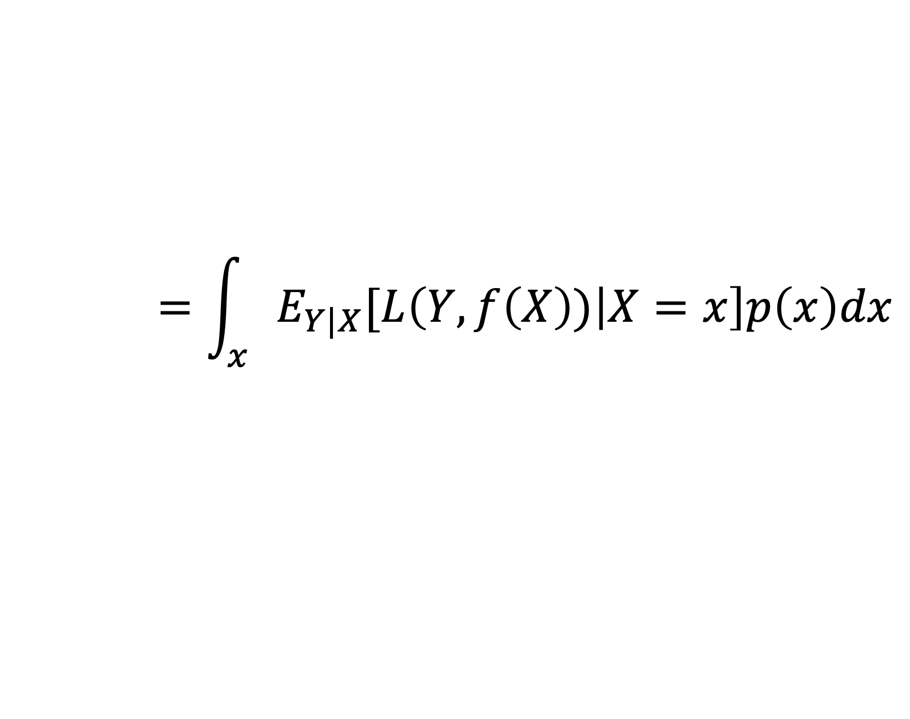
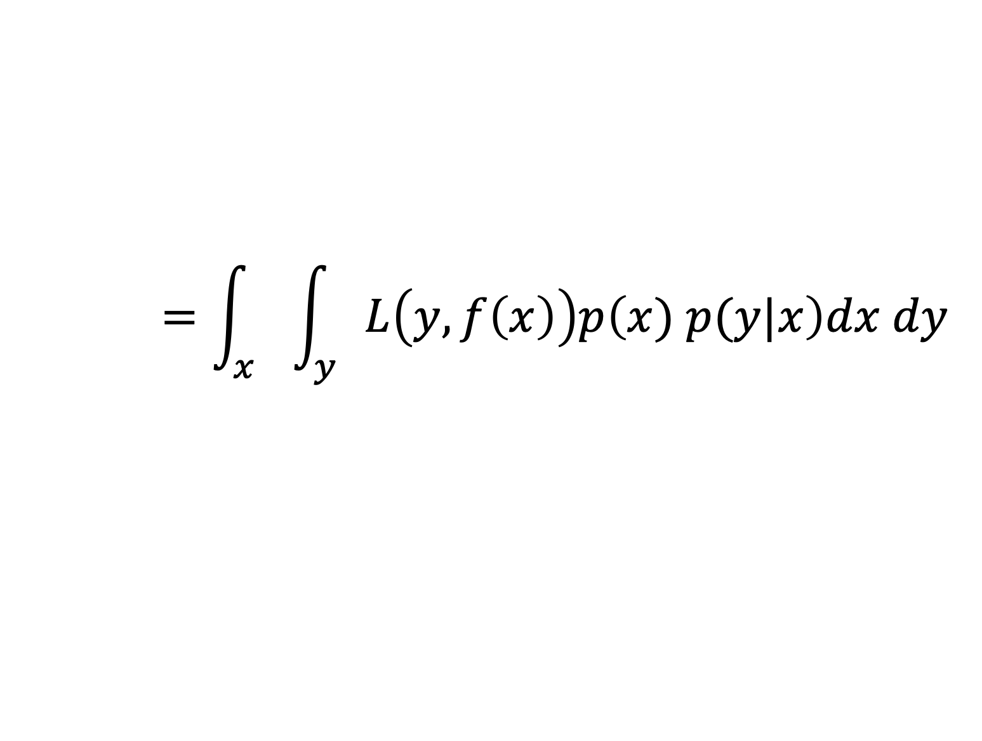
Derivation of $EPE(f)$ Continued
$$=\int_{x}{\int_{y}{L\left(y, f\left(x\right)\right)p\left(x) p(y|x\right)dx dy}}$$
From previous slide
$$=\int_{x}{\left(\int_{y}{L(y, f\left(x\right))p\left(y | x\right)dy}\right)p\left(x\right)dx}$$
Fubini’s Theorem
$$=\int_{x}{E_{Y|X}[L\left(Y, f\left(X\right)) | X=x\right]p\left(x\right)dx}$$
Definition of Conditional Expectation
$$=E_{X}[E_{Y|X}[L\left(Y, f\left(X\right)) | X\right]]$$
Definition of Expectation
Notes:
Note that we can use Fubini’s theorem because the loss function is continuous and will, therefore, be measurable. The probability density function is also measurable and the product of two measurable functions is measurable.

Slide 15
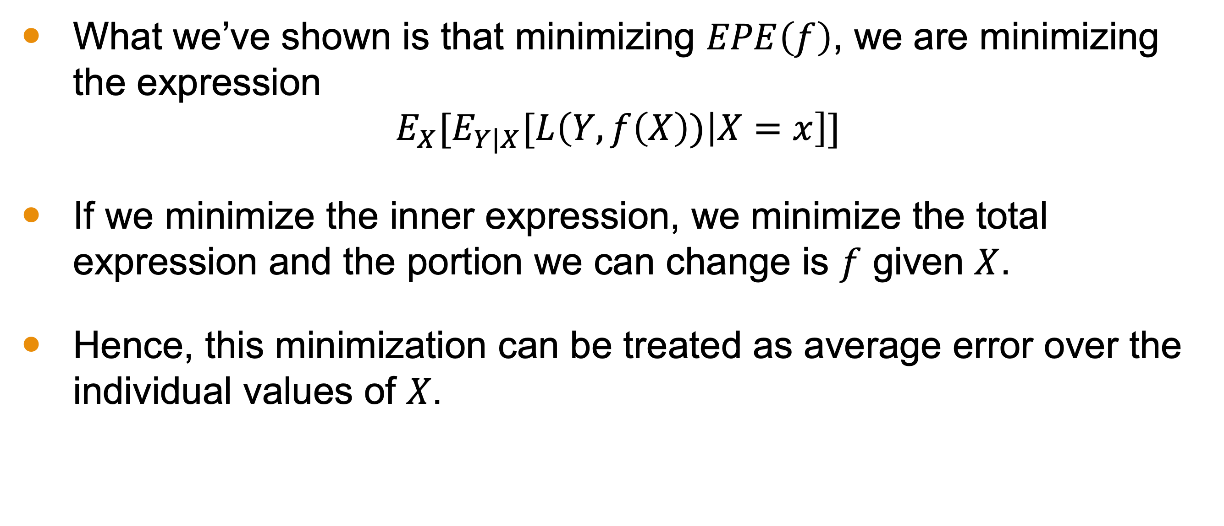

Minimizing $EPE(f)$
What we’ve shown is that minimizing $EPE\left(f\right)$, we are minimizing the expression
$$E_{X}[E_{Y|X}[L\left(Y, f\left(X\right)) | X=x\right]]$$
If we minimize the inner expression, we minimize the total expression and the portion we can change is $f$ given $X$.
Hence, this minimization can be treated as average error over the individual values of $X$.

Slide 16
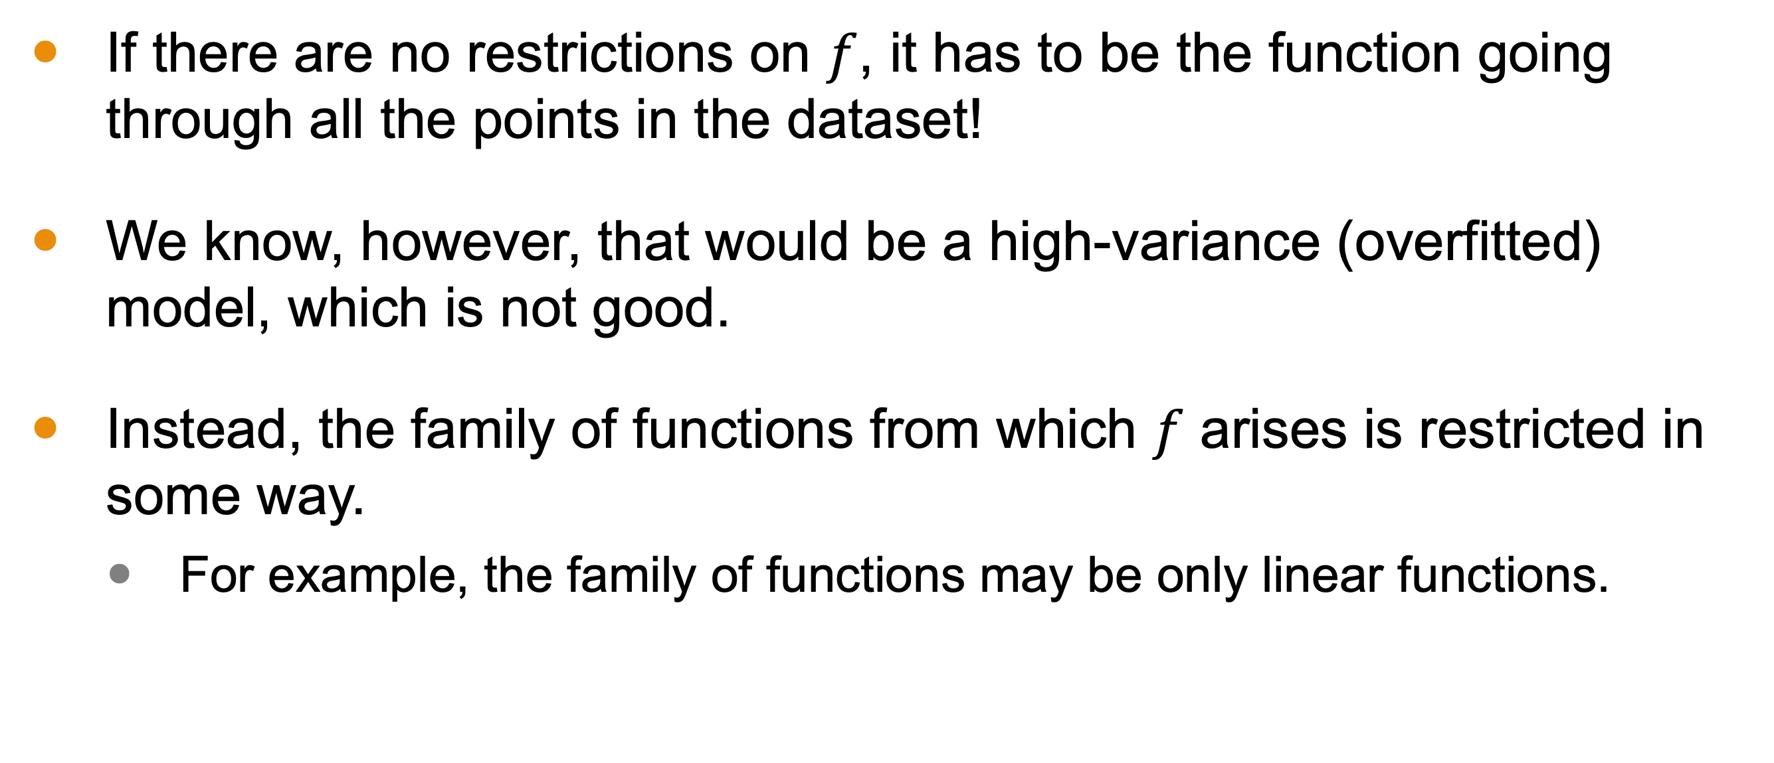

Consequences of Minimizing $EPE(f)$
If there are no restrictions on $f$, it has to be the function going through all the points in the dataset!
We know, however, that would be a high-variance (overfitted) model, which is not good.
Instead, the family of functions from which $f$ arises is restricted in some way.
For example, the family of functions may be only linear functions.

Slide 17
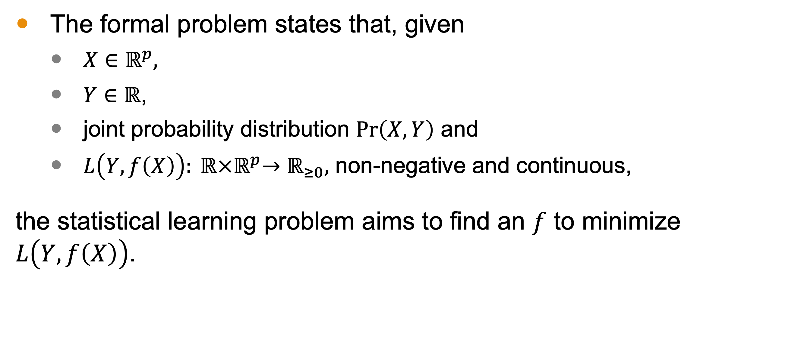
Conclusion
The formal problem states that, given
$X∈ℝ^{p},$
$Y∈ℝ$,
joint probability distribution $\operatorname{Pr}\left(X,Y\right)$ and
$L\left(Y, f\left(X\right)\right): ℝ{×ℝ}^{p}→ℝ_{≥0},$ non-negative and continuous,
the statistical learning problem aims to find an $f$ to minimize $L\left(Y, f\left(X\right)\right)$.

Slide 18
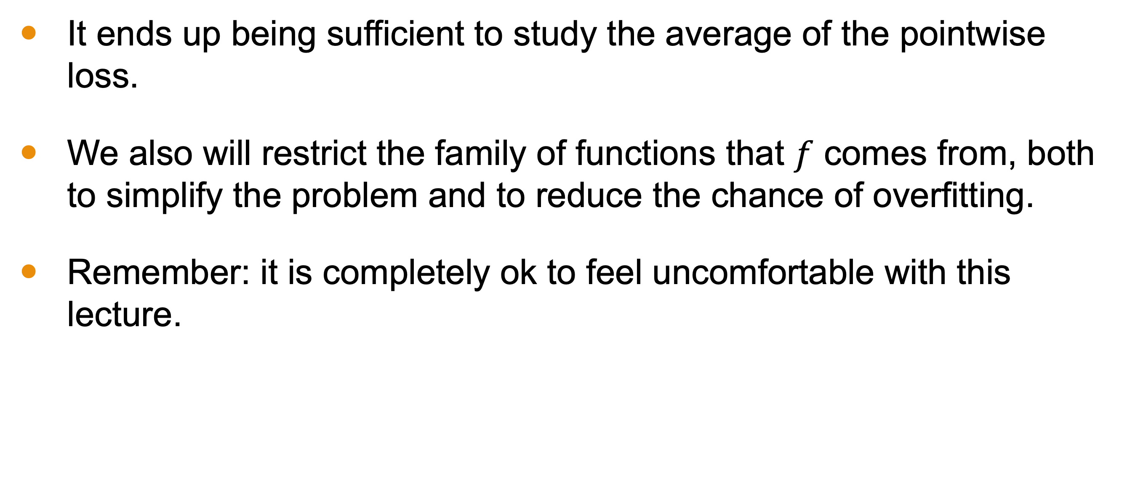
Conclusion
It ends up being sufficient to study the average of the pointwise loss.
We also will restrict the family of functions that $f$ comes from, both to simplify the problem and to reduce the chance of overfitting.
Remember: it is completely ok to feel uncomfortable with this lecture.
Notes:
Especially if your prerequisite course in probability or statistics lacked formal treatment of the mathematics

